Slide 1
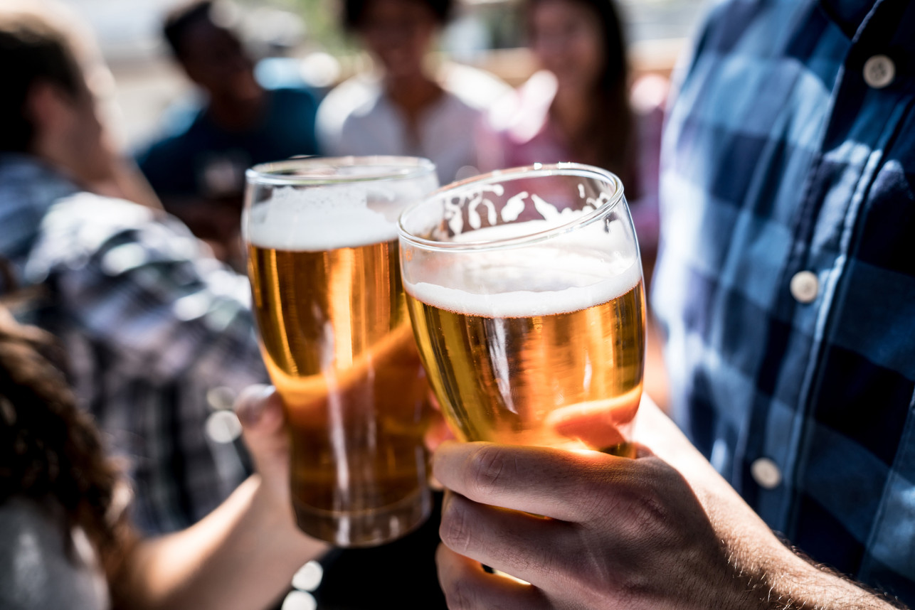
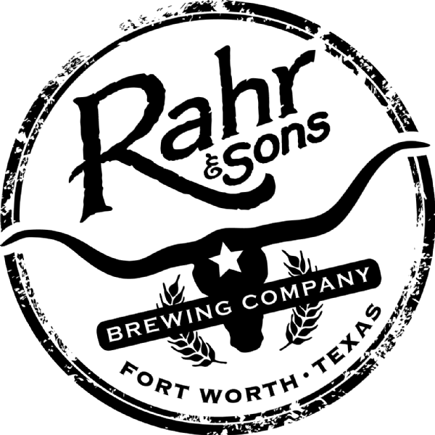
Brew-Forward 2019
Brewpub placement in the Dallas area
We see Rahr & Sons missing out on market share as a brewery due to its’ large-scale operation.
Notes:
I would like to thank you for taking the time to meet with us today.
We see Rahr & Sons missing out on market share as a brewery due to its’ large-scale operation.
I would like to take the next 5 minutes to go over what we feel is a solution to move you into a more agile position as a brewery.

Slide 2
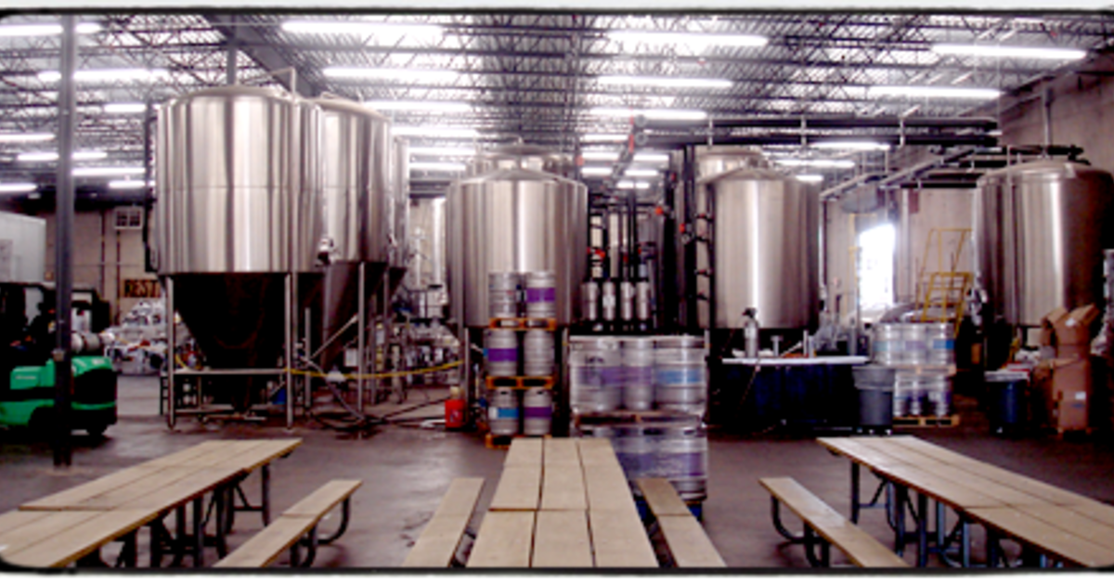
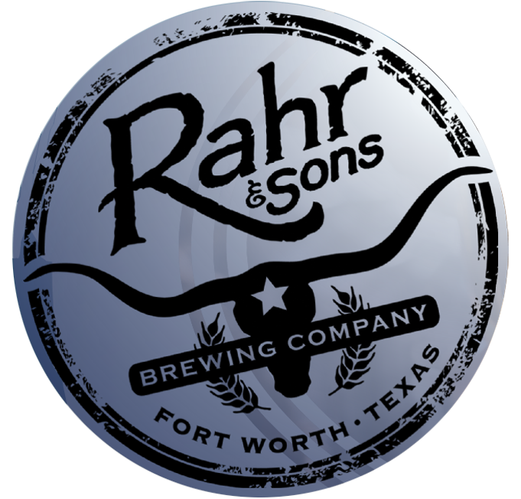
The History
Rahr & Sons Brewing Company – 2004
Full-scale brewery, in a time where Craft Breweries were still new.
In the 15 years since, the area has exploded with now over 80+ breweries and brewpub.
Most popular being brewpubs.
Notes:
Rahr & Sons Brewing Company started in 2004 as a full-scale brewery, in a time where Craft Breweries were still new.
In the 15 years since, the Dallas / Fort Worth Craft Beer scene has exploded with now over 80 breweries and brewpub.
The most popular showing to be brewpubs.

Slide 3
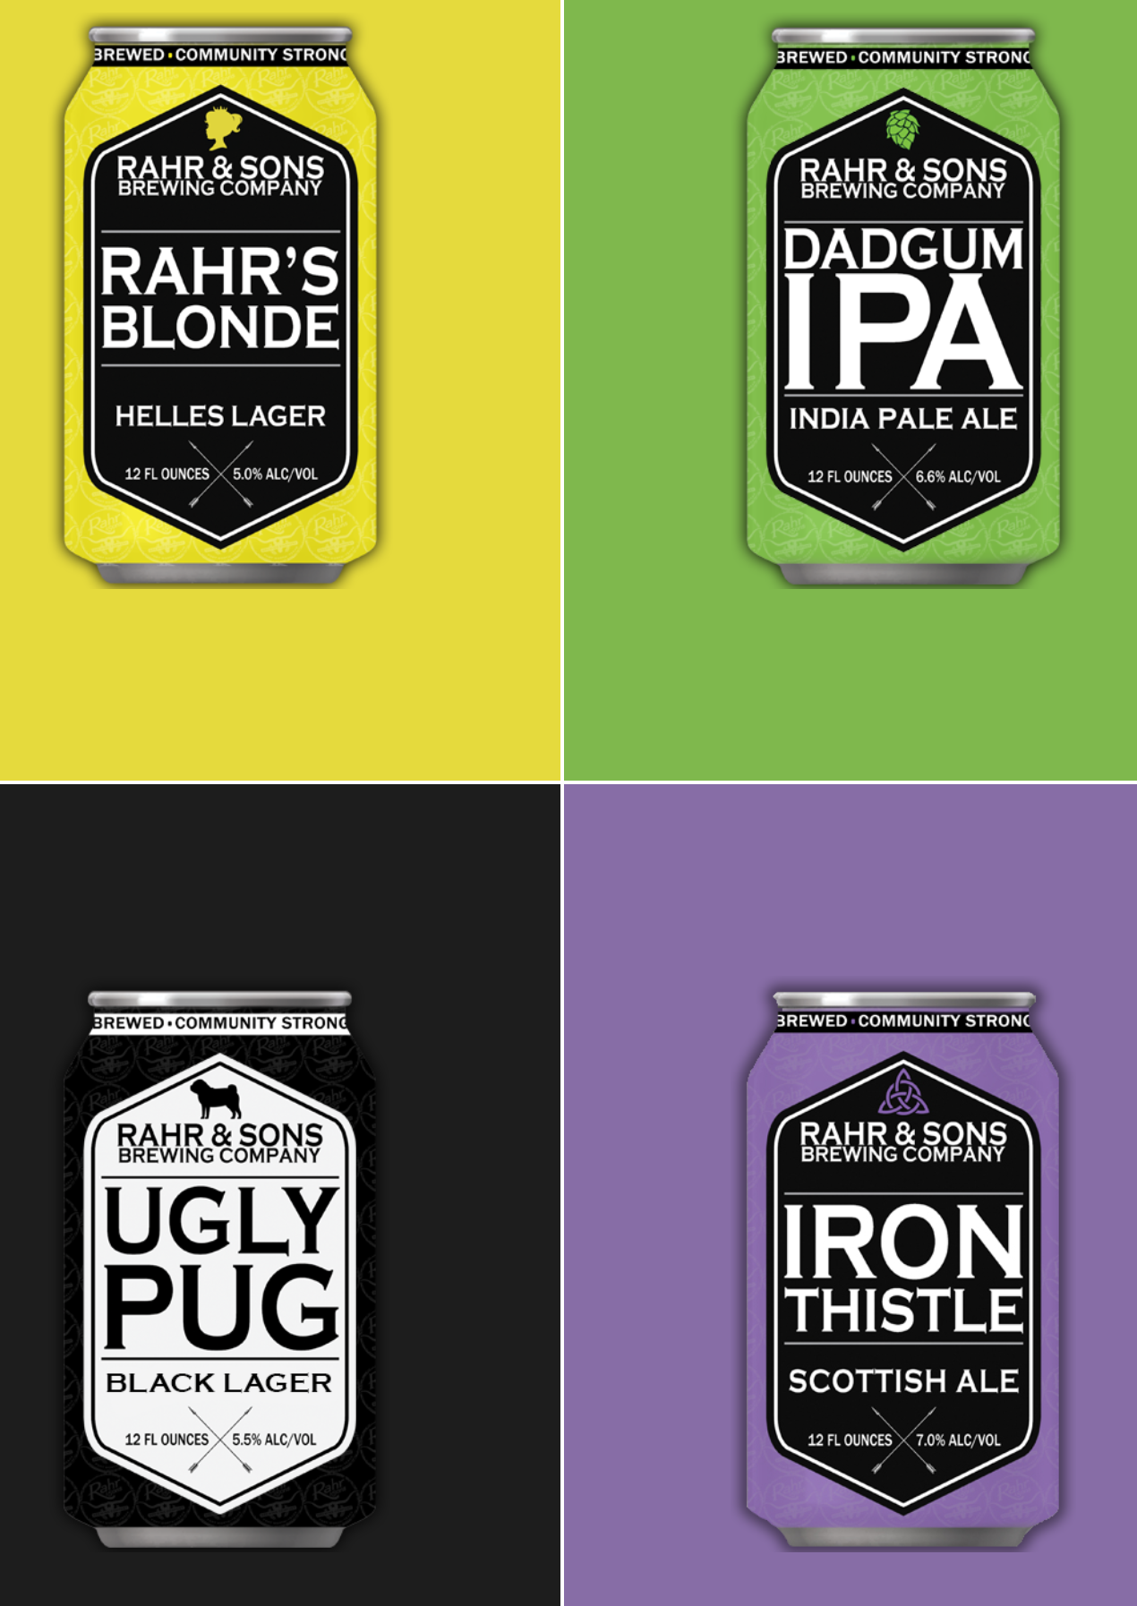

The Problem
Rahr is constrained as a brewery with only a large-scale operation.
Website: 16 beers - 9 seasonal and specialty brews. Your available beer count is only 7.
Untapped: 32 Unique Beers
Your competitor down the street as a brewpub - over 160 unique beers
Notes:
Here is what we see as the problem.
Rahr & Sons’ current beer list on your website consist of sixteen beers with 9 of those being seasonal and specialty brews,
showing your available beer count is only 7.
According to Untapped, a beer social rating application, Rahr has produced a total of only 32 unique beers
while its competitor down the street as a brewpub has made over 160 unique beers.
This is why we say,
“We see Rahr & Sons at risk of getting constrained and missing out on market share as a brewery due to its’ large-scale operation and taproom only.”

Slide 4
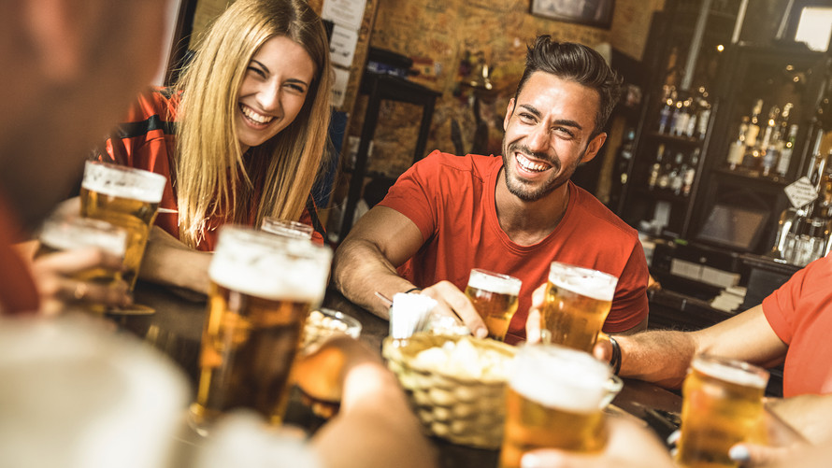
The Market
Millennials are what is driving the craft and brewpub industry.
“People spend more on craft beer every month than they do on their monthly cell phone and utilities bills.”
“With spirits, it's less about being offended by what has been on offer from large producers and more of an eagerness to discover something new.”
Notes:
Studies show that Millennials (people born between the early 1980s and early 2000s) are what is driving the craft and brewpub industry.
Jeanette Settembre with MarketWatch states:
“People spend more on craft beer every month than they do on their monthly cell phone and utilities bills.”
Corie Brown with Zester Daily stated
“With spirits, it's less about being offended by what has been on offer from large producers and more of an eagerness to discover something new.”
You are missing out on market share by not offering “something new”. Millennials and those around that age group respond to a new and rotating tap wall and experiences.

Slide 5
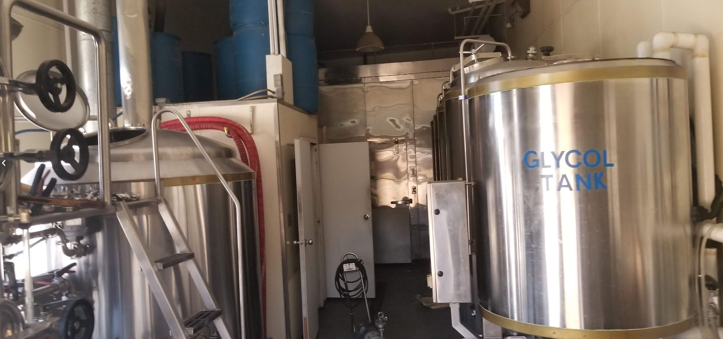
Our Vision
Grow Rahr & Sons Brewing by determining a second location to open a brewpub with a smaller “pilot” brew house.
Notes:
We believe Rahr & Sons can increase customer loyalty and more important, gain market share by creating a brewpub footprint in Dallas.
We want to help Rahr & Sons Brewing grow, by determining a location to open a brewpub with a small “pilot” brew house.
Thus, meeting market demand by providing a brewpub with the ability to turn out new and innovative beers on a much higher scale than at your larger brewery.
This area will also serve as an incubator for new and innovative beers.

Slide 6
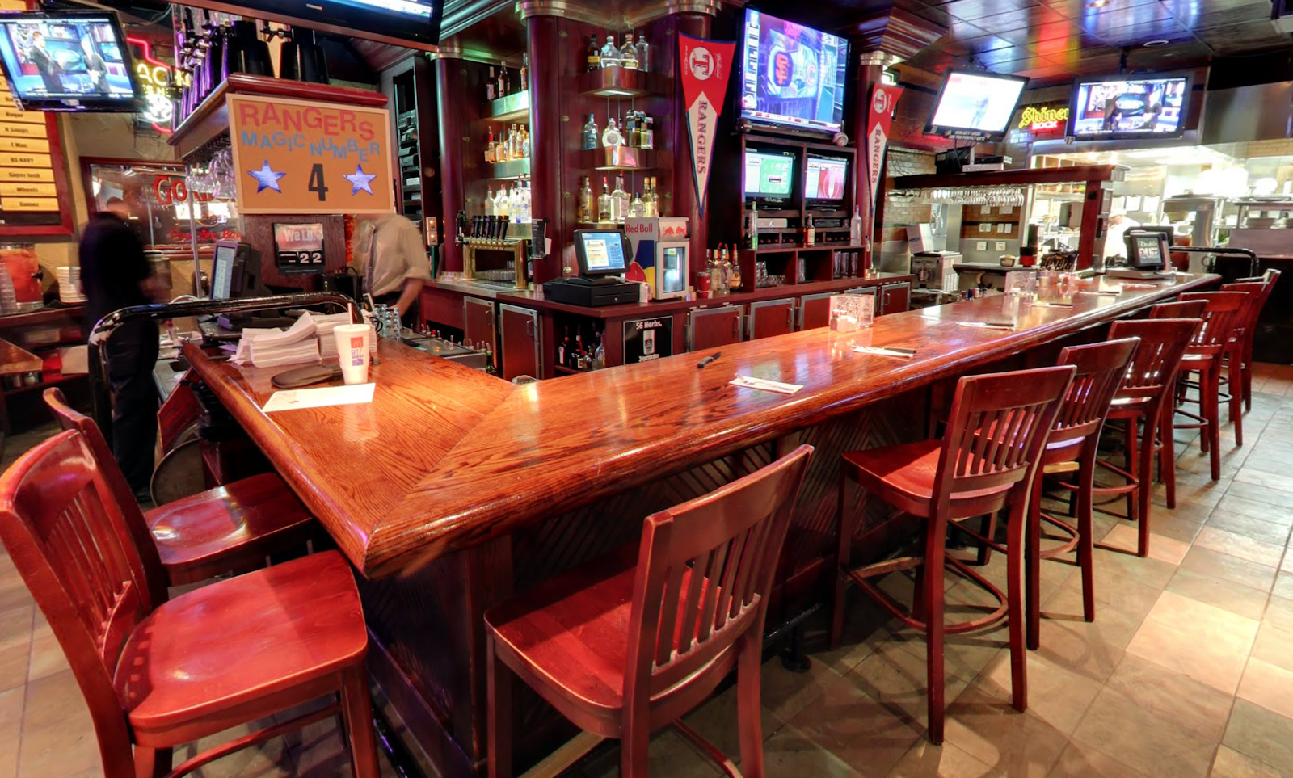
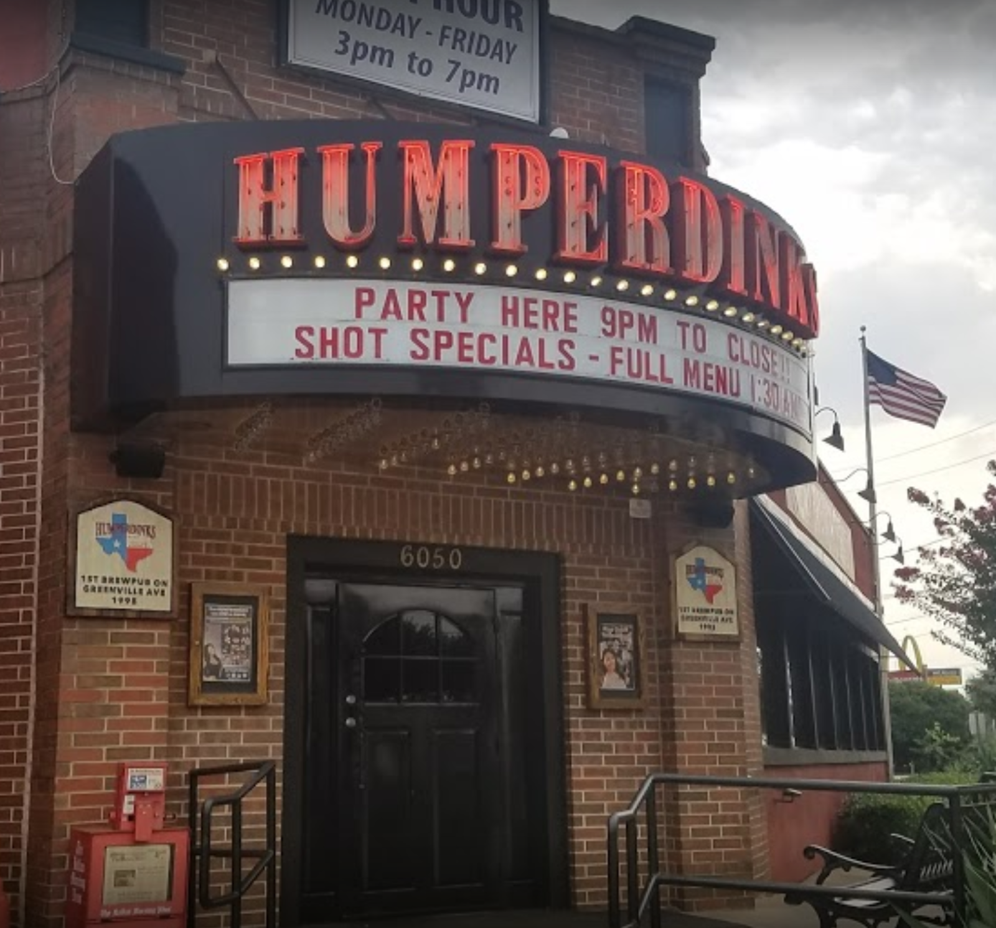
Why Now
There is a perfect opportunity at an existing brewpub location in the Dallas area.
Notes:
There is a perfect opportunity at an existing brewpub location in the Dallas area.
The space contains a full-size bar, large areas for eating a gaming section and a 10-barrel brewing system.
The reason for the failure of the current company shows to be a inability to inspire Millennials, and customers in general to return on a regular basis.
Looking at the data of Humperdinks we see a downward trend in check-ins and ratings.
Humperdinks keep a consistent count of 6 inhouse beers on tap.
Offering the same craft experience time after time is not what will keep this age group returning.
Thomas Touring, director of restaurant operations for the House of Blues chain of music venues,
says he shifted his restaurants to an all-craft beer menu because his customers were demanding local beers.
Once he made the shift, beer sales went up and so did food sales.

Slide 7
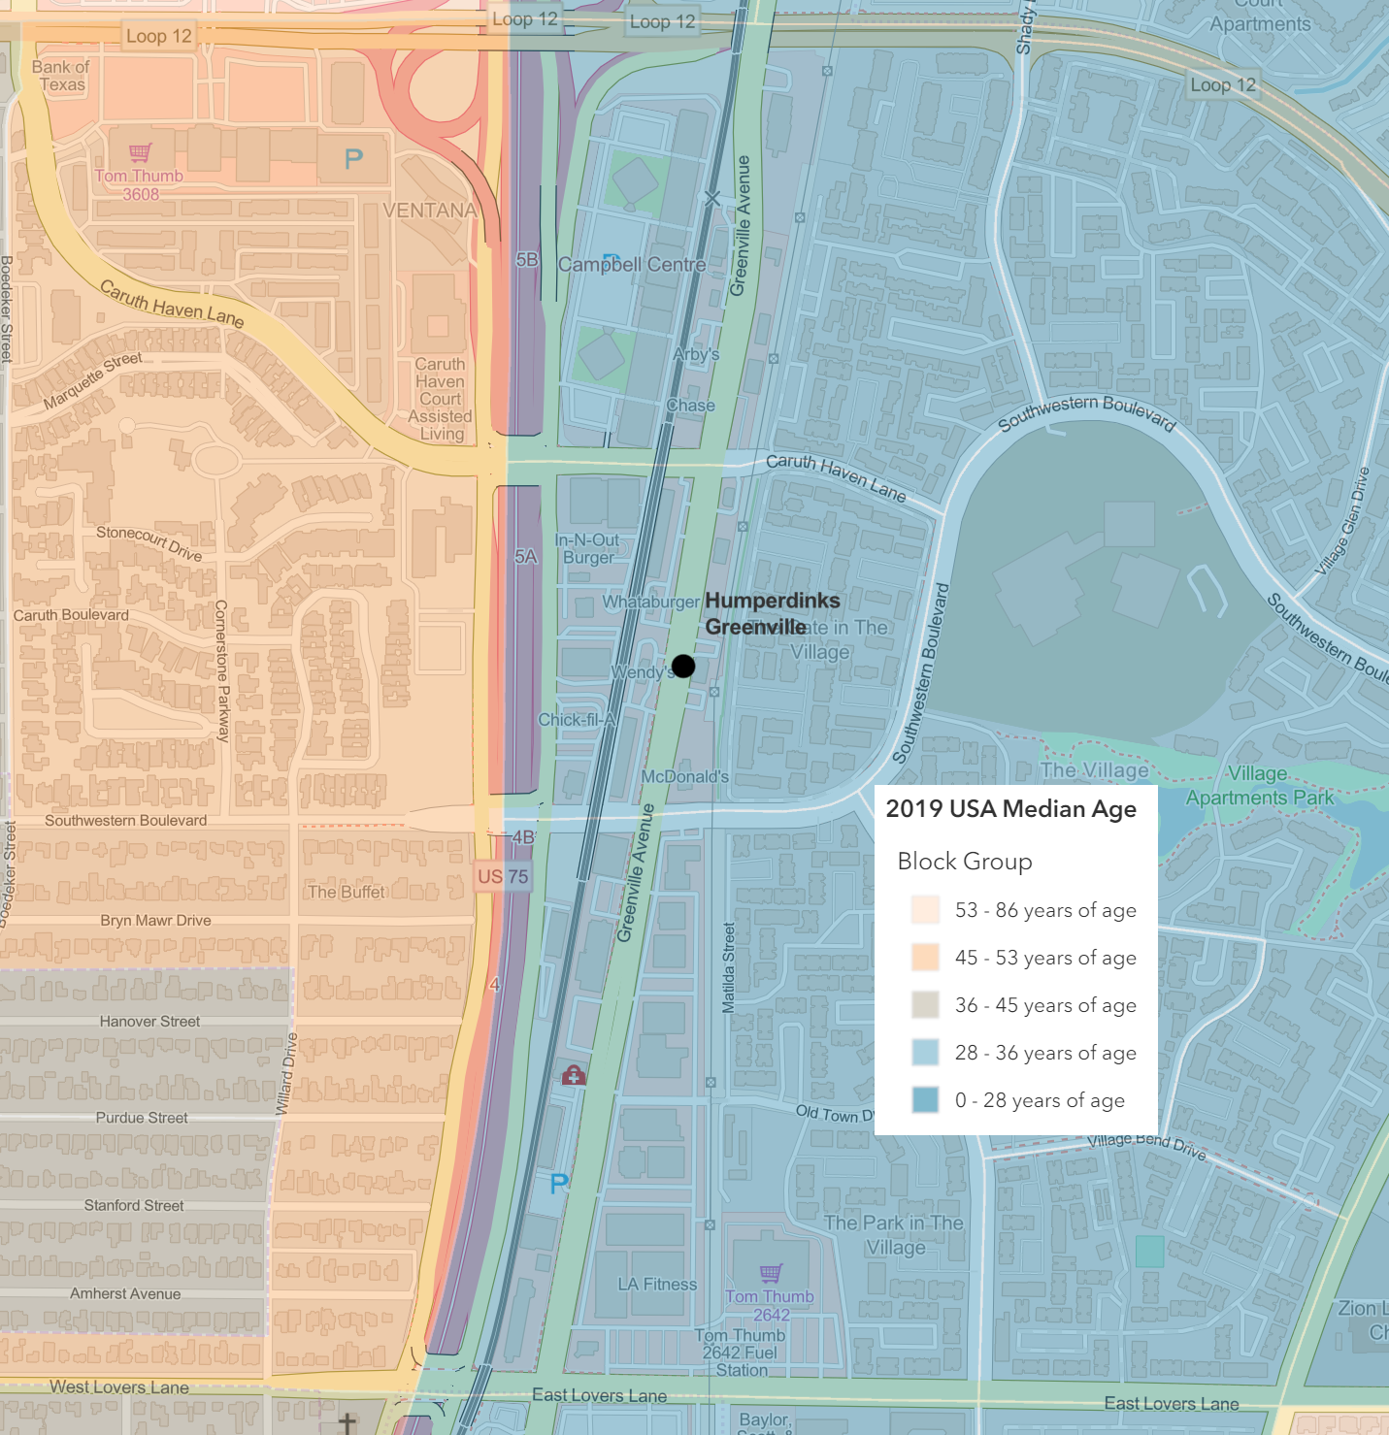
The Area
2019 Data
Median Age: 28 to 36
Disposable income: $39,000 to $188,000
Traffic Counts: Greenville Avenue are - 24,008 North Central Expressway - 322,801
The area shows to able to handle a newly reopened brewpub.
Notes:
The area shows to be able to handle a newly reopened brewpub,
with the 2019 median age being 28 to 36 and one censes track away being 45 to 53.
The disposable income, alone, in the area ranges from $39,000 to $188,000 per household.
Traffic counts on Greenville Avenue are 24,008 and on North Central Expressway, just, a 10th of a mile away going up to 322,801 per day.

Slide 8


Management Team
The labor component must be considered
Local Management
Rahr & Sons Representative
Brewmaster
Run the facility
Manage a monthly calendar of events
Brewpub buildout
training of the new management team
Oversee local beer production
hire assistant staff
Notes:
The labor component must be considered.
There will be need to hire management to run the facility and manage a monthly calendar of events. There will also be a Brewmaster on staff to oversee local beer production. We also feel a management representative from Rahr should be involve in the buildout and training of the new management team to assure that the brand is correctly represented in the new facility.

Slide 9
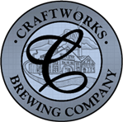
Business Model
Lease and retrofit Humperdink’s Resturant with existing brewhosue
Establish membership program, offering mugs, food discounts, rewards for unique beers
High rotation of beers, instead of 30 standard offerings we offer 100 unique beers year around
Investment
Space
Profit
Long term lease:
$3.70 - SF
6,785 bring the monthly total to $25,104.50
Full-size bar
Large areas for eating a gaming
15-barrel brewing area
Money will be generated by offering craft food & in house and carry away beer sales.
Loyalty membership program
Notes:
The building is for long term lease at $3.70 a square foot.
The space contains a full-size bar, large areas for eating a gaming section and a 10-barrel brewing system.
In this setting smaller means faster.
A 10 barrel brewhouse at 50 brew weeks per year is able to produce 10 different brews per week.
In new operations 2-3 brews per week is common.
The total square footage is 6,785 bring the monthly rent to a little over 25 thousand.
Money will be generated by food and in house and carry away beer sales.
There will be a membership program to encourage customer loyalty and return.
Several beers will be on tap including Rahr & Sons’ staples as well as rotating inhouse beers.

Slide 10




Thank You
Chris Ballenger & Chad Madding
+1 555-0100
chris@rahrbrewing.com
rahrbrewing.com
Notes:
Thank you for allowing us to share this exciting opportunity with you today. If you have any questions, please do not hesitate to contact us.

